Slide 1

Right time to invest in Brazilian market
Amruta Chaudhary
Satyendra Kumar
Satya Fitz

Slide 2
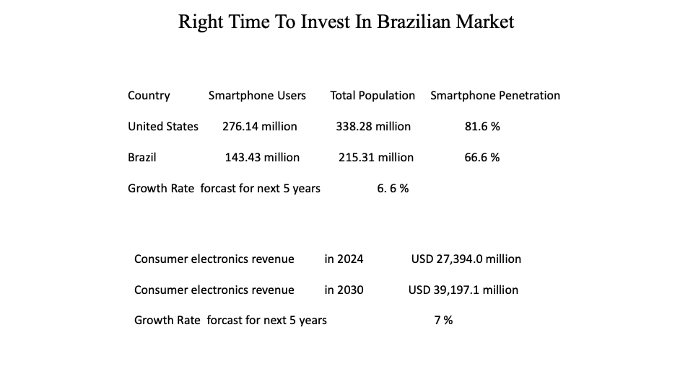

Slide 3
We are focusing on 3 key points
Product availability
Delivery time
Customer satisfaction

Slide 4
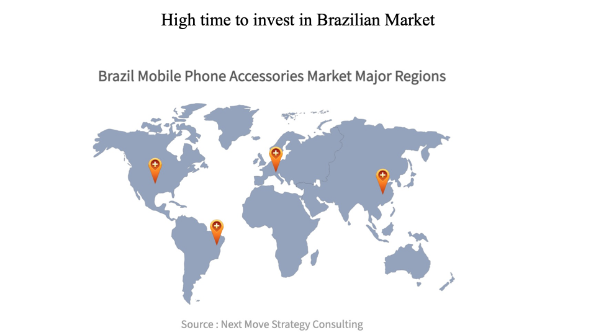
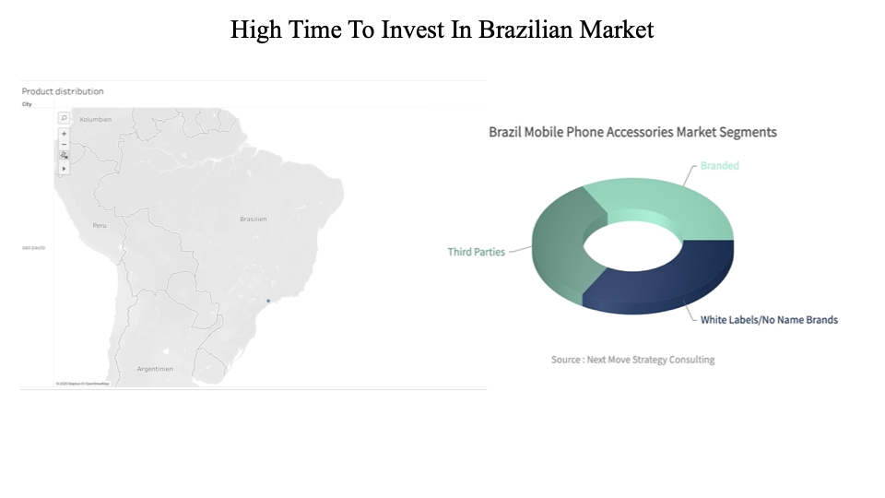
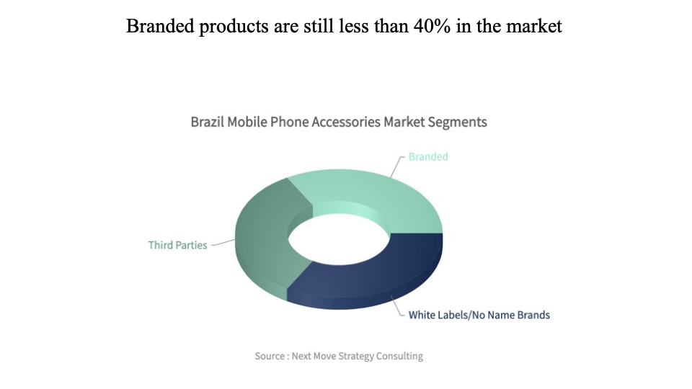
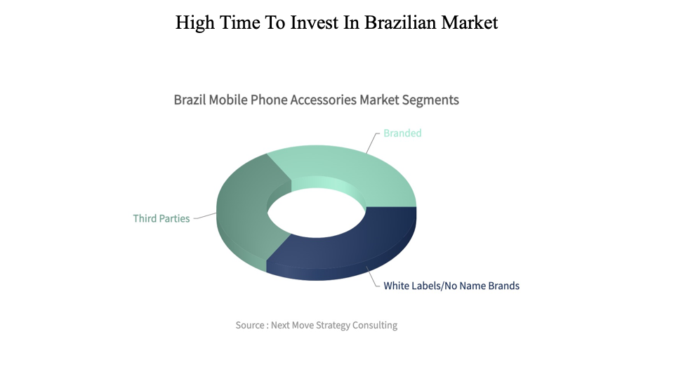

Slide 5
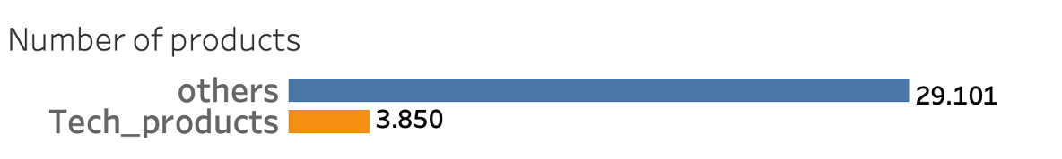
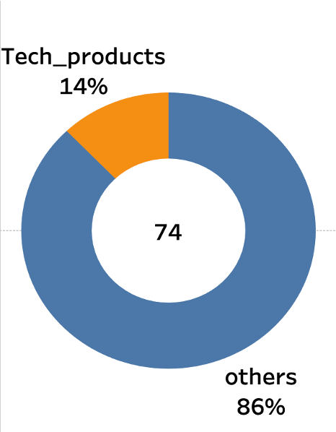


Number of Tech products need to increase
Percentage of Tech product

Slide 6
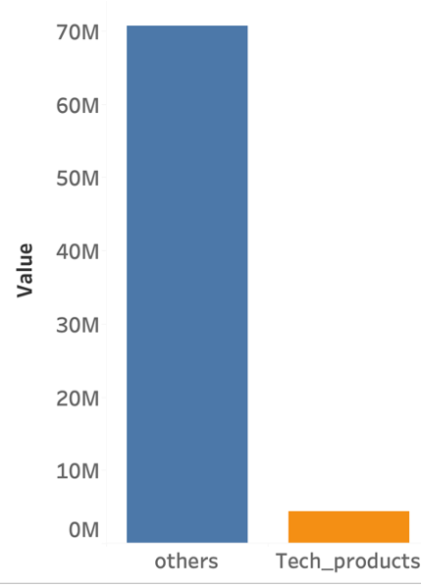
Tech products revenue can be improve
Total revenue

Slide 7
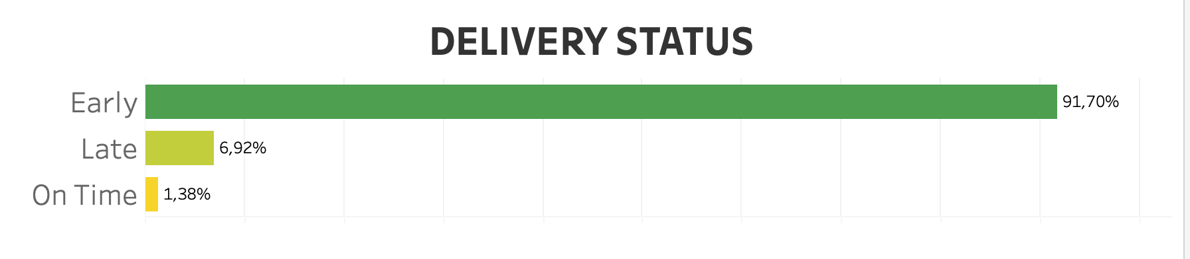
Magist’s delivery is going through the roof 🚀

Slide 8
12, 5 days
Is the average delivery time

Slide 9

How are customers reacting to this?
O produto foi entregue muito antes do esperado. Ótima agilidade.
Muito bom!
A entrega foi super rápida!
Nota 10 pela entrega.

Slide 10

avg. estimated delivery time:
24 days

Slide 11
How happy are customers?
58 % of all ratings are 5 stars
19 % 4 stars
8 % 3 stars
3 % 2 stars
12 % 1 star

Slide 12
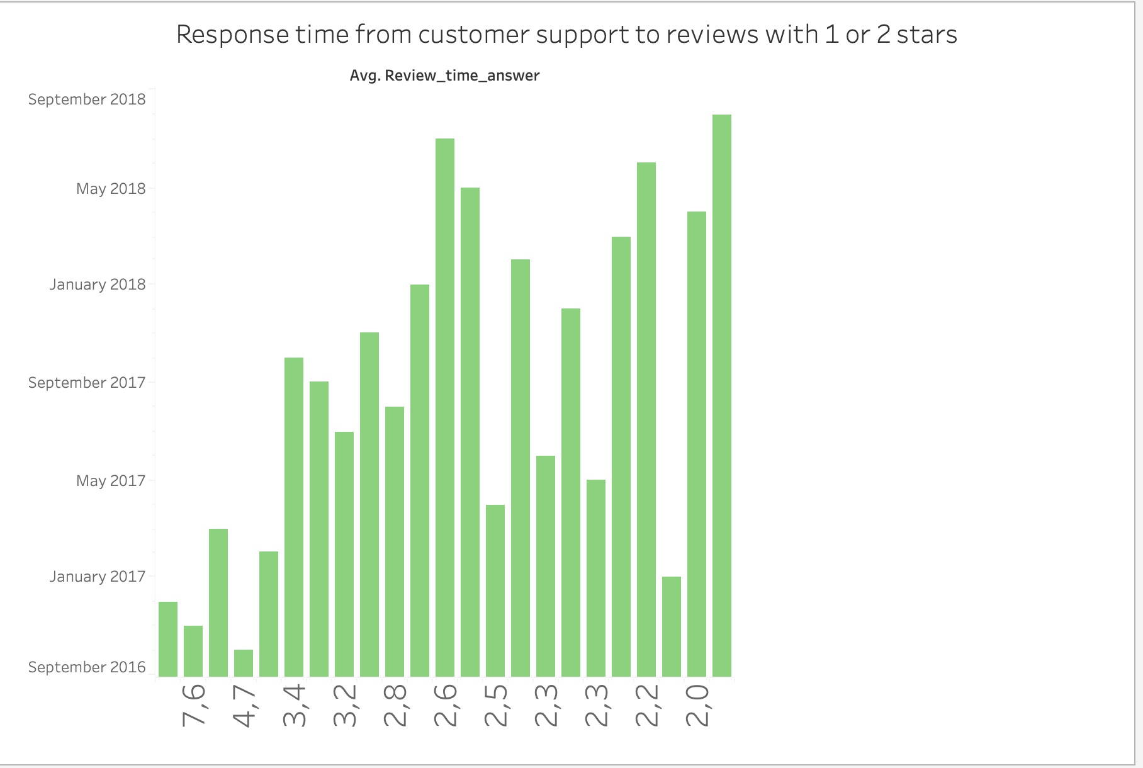
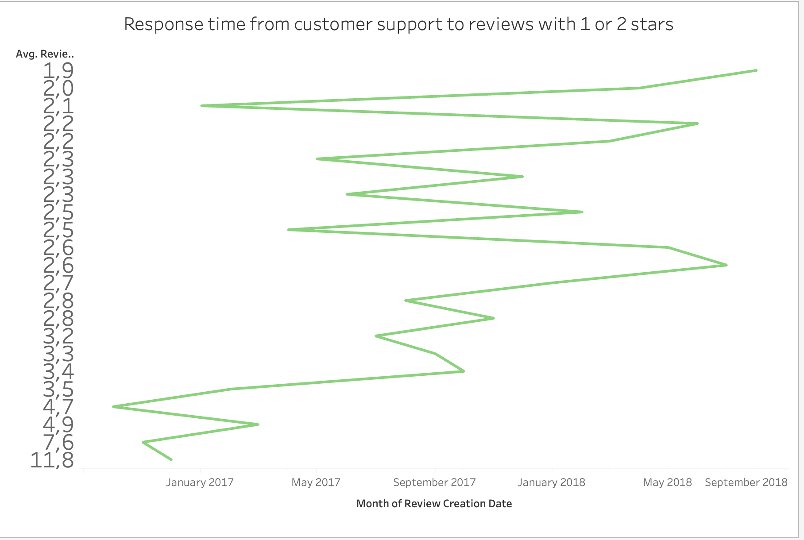

Slide 13
Conclusions
We can make a big impact in the Brazilian market by improving
Boosting Tech products
Improving delivery time
Customer support response time

Slide 14


